Slide 1

Rainfall Prediction Using Machine Learning - Python
Predicting rainfall using classification algorithms

Slide 2
Introduction
Aim : To predict rainfall using historical weather data with machine learning techniques.
Importance : Rainfall prediction aids in agriculture , disaster management , and planning.

Slide 3
Tools & technologies
1. Languages & Libraries : Python , Pandas , NumPy , Matplotlib , Seaborn
2. ML Libraries : scikit-learn , XG Boost , imbalanced-learn
3. Techniques : Data cleaning , feature scaling , class balancing ,model evaluation

Slide 4

Dataset overview
Dataset : Rainfall.csv
Features : Weather-related parameters
Target : rainfall (Rain/No Rain)
Shape : Rows x Columns
Missing values handled using mean imputation

Slide 5
Data preprocessing
Steps:
Renamed columns for consistency
Handled missing values
Applied StandardScaler for feature scaling
Balanced dataset using RandomOverSampler

Slide 6
EXPLORATORY DATA ANALYSIS
Visualizations :
1. Pie chart of rainfall distribution
2. Grouped analysis for rainfall vs other features
Purpose :
1. Understand patterns and correlations in the data

Slide 7
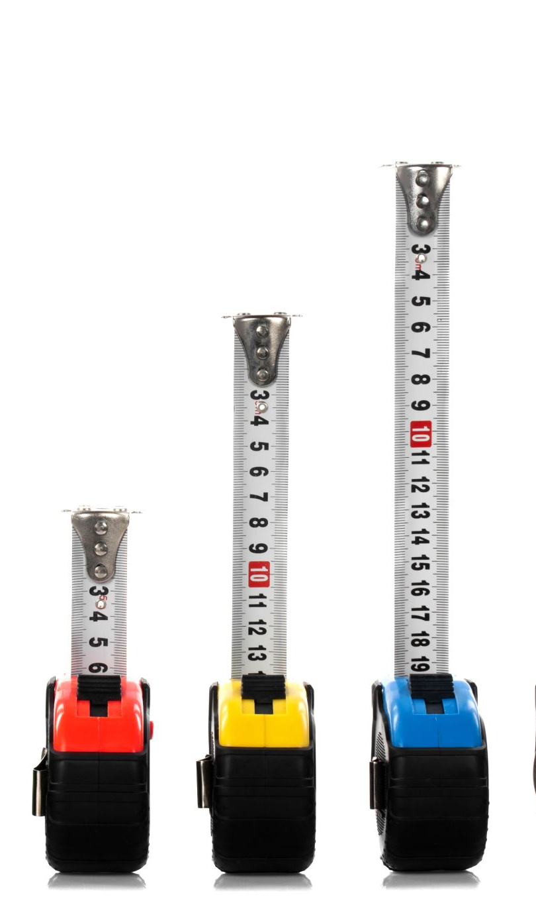
Machine Learning Models
~ Train/Test Split : 80/20
~ Algorithms Used : 1.Logistic Regression
2. Support Vector Machine (SVM)
3. XG Boost Classifier
~ Training Process : Standard ML pipeline with model fitting and predictions

Slide 8

MODEL EVALUATION
Evaluation Metrics :
Accuracy
Confusion Matrix
Classification Report (Precision , Recall , F1-score)
Comparison Table : Accuracy scores of all model side by side

Slide 9
Conclusion
Best Model : XG Boost showed the highest accuracy
Key Takeaways :
Proper preprocessing improves model accuracy
Balancing classes is critical for binary classification tasks

Slide 10

FUTURE WORK
Integrate more real-world features (e.g., humidity , wind speed )
Use deep learning models like LSTM or GRU
Real-time predictions using live weather APIs

Slide 11

Related ReSearch PAPERs
Predicting Rainfall Using Machine Learning , Deep Learning , and Time Series Approaches
Comparative Analysis of Different Rainfall Prediction Models : A Case Study
Machine Learning Techniques to Predict Daily Rainfall Amount

Slide 12

GITHUB LINK
https://github.com/Abhi20037500/AIML-project

